Slide 1
Transitioning to the ESXi Hypervisor Architecture – What Customers Need to Know
VMware, February 2011

Slide 2
Agenda
ESXi Convergence and ESXi Value Proposition
Hardware Monitoring and System Management with ESXi
Security and Deployment Options
Command Line Interfaces
Diagnostics and troubleshooting
Answering common questions
Resources and call to action

Slide 3



VMware vSphere 4.1 and earlier support two hypervisors architectures: VMware ESXi or ESX
VMware’s virtualization platform includes two components:
VMware vSphere 4.1 = virtualization software
VMware vSphere 4.1 is available in several editions at different levels of functionality
Customers can choose to install vSphere 4.1 using either the VMware ESXi or ESX
VMware vCenter Server 4.1 = virtualization management software
VMware vCenter Server is necessary for advanced features such as VMotion, HA, etc.
VMware vSphere
VMware vSphere
VMware vSphere
VMware vCenter Server
Notes:
First let’s clear the stage from some of the confusion that our complex product naming may generate. When you look at a VMware virtualization platform there are essentially 2 components: virtualization software (vSphere) and virtualization management software (vCenter). vSphere is what our customer purchase and install on servers to run VMs. It is available in many edititions at different price levels and functionality. vCenter provides centralize management and is necessary to take advantage of advanced vSphere features such as vmotion, HA, etc. Up until the current 4.1 release of vSPhere, when customer install vSphere today they have the option to deploy it using either the ESX and ESXi hypervisor architecture.

Slide 4
Converging to ESXi with the next vSphere release
With the GA of vSphere 4.1 in July 2010 VMware officially announced that starting with the next vSphere our hypervisor architecture will converge to ESXi
From the release note:
VMware vSphere 4.1 and its subsequent update and patch releases are the last releases to include both ESX and ESXi hypervisor architectures. Future major releases of VMware vSphere will include only the VMware ESXi architecture.
VMware recommends that customers start transitioning to the ESXi architecture when deploying VMware vSphere 4.1.
VMware will continue to provide technical support for VMware ESX according to the VMware vSphere support policy on the VMware Enterprise Infrastructure Support page.
To learn more about the ESXi architecture and how to migrate from ESX to ESXi, go to the VMware ESXi and ESX InfoCenter.
Notes:
Starting from the next release however vSphere will on be avilable with the ESXi hypervisor architecture. This slide shows the release note that we published when we launched vSPhere 4.1 last July. ESX will continued to be supported according to our standard policy, however we won’t develop it further and it won’t allow customers to take advantage of the new features that will be part of vSphere future releases. For this reason, as you can see from the note we recommend that any new deployment of vSPhere even in the current version are done using ESXi architecture and that customers migrate to ESXi with their upgrade vSPhere 4.1

Slide 5
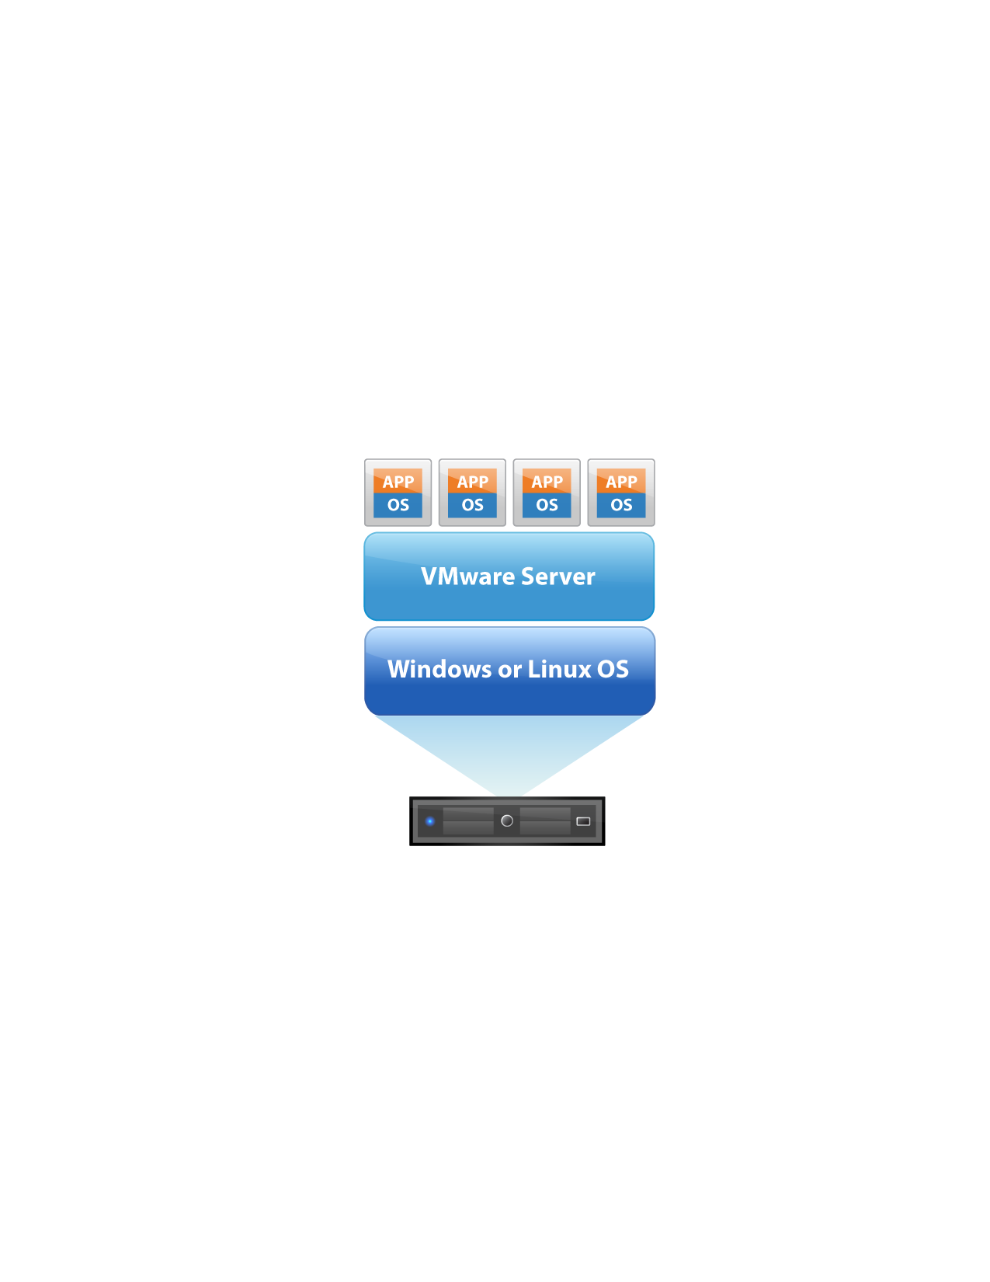


VMware ESXi: 3rd Generation Hypervisor Architecture
VMware GSX
(VMware Server)
Installs as an application
Runs on a host OS
Depends on OS for resource management
VMware ESX
architecture
Installs “bare metal”
Relies on a Linux OS (Service Console) for running partner agents and scripting
VMware ESXi architecture
Installs “bare metal”
Management tasks are moved outside of the hypervisor
VMware ESX
Service Console
VMkernel
VMware ESXi
VMkernel
2001
2003
2007
The ESXi architecture runs independently of a general purpose OS, simplifying hypervisor management and improving security.
Notes:
this is a key slide to describe how and why we have evolved our architecture to arrive at ESXi. architecture evolution Virtualization is a quickly evolving market and as such we have to evolve our products to drive the next phase of computing. Let’s take a trip down memory lane…I’m not sure how many of you had GSX, our first hypervisor architecture, but in the GSX architecture, hypervisor installed on the OS as an application and we relied heavily on the OS for resource management. Of course performance and reliability are jeopardized in that type of architecture. To move customers from virtualizing test / dev apps and really start considering virtualization for their production applications, we knew we needed to re-architect the hypervisor to get rid of its OS handicap. So in 2003, we introduced ESX, which runs bare metal and we evolved it to have the right level of reliability and performance to virtualize production applications such as Exchange, databases, etc. If we had not made the investment in the enabling architecture, virtualization adoption would have been much slower. We are again at a cross roads with virtualization, where we are moving from 10% virtual to a 100% virtual, a world where virtualization is second nature and the datacenter is converted into an elastic cloud. This world requires a light weight hypervisor that is incredibly simple and easy to deploy and manage, and we need to start the next phase of innovation that simplifies deployment and ongoing management of the hypervisor even further. This is precisely why we started investing in ESXi many years ago. ESXi is very similar to ESX – in fact they have the same underlying code base (which is about 100 MB) – but ESX architecture also includes a 2 GB service console, which is a stripped down Linux OS (RHEL) that is used for serviceability and partner integration. This bulky OS component comes with a lot of junk than we don’t need…It is difficult to manage, secure, and limits our nimbleness. In fact, its functionality can be replaced with more appropriate tools that deliver all the benefits without the limitations. What we have done with ESXi is take away this bulky OS, and enhanced the platform with only the serviceability capabilities that we need and have implemented them in a way that is optimal for a distributed Cloud OS. Scripting is now done with remote tools – namely the vCLI and PowerCLI. Partner integration is now API-based instead of agent-based. This allows us to have a small and stateless architecture that is very easy to deploy and manage. So let me go over some of the benefits of the ESXi architecture. ------
Additional background info for interested presenters:
Difference between ESX and ESXI:
VMware ESX and VMware ESXi are both bare-metal hypervisors that install directly on the server hardware. Both provide industry-leading performance and scalability; the difference resides in the architecture and the operational management of VMware ESXi. Although neither hypervisor relies on an OS for resource management, VMware ESX relies on a Linux operating system, called the service console, to perform two management functions: executing scripts and installing third party agents for hardware monitoring, backup or systems management. The service console has been removed from ESXi, drastically reducing the hypervisor footprint and completing the ongoing trend of migrating management functionality from the local command line interface to remote management tools. The smaller code base of ESXi represents a smaller “attack surface” and less code to patch, improving reliability and security. The functionally of the service console is replaced by remote command line interfaces and adherence to system management standards.

Slide 6
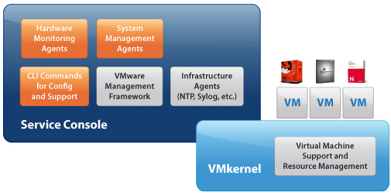
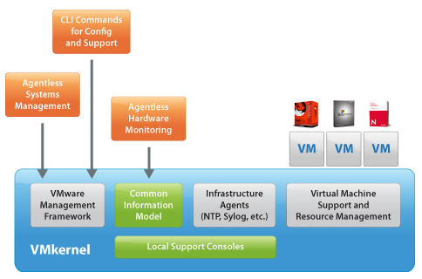
VMware ESXi and ESX hypervisor architectures comparison
VMware ESX Hypervisor Architecture
VMware ESXi Hypervisor Architecture
Code base disk footprint: ~ 2GB
VMware agents run in Console OS
Nearly all other management functionality provided by agents running in the Console OS
Users must log into Console OS in order to run commands for configuration and diagnostics
Code base disk footprint: <100 MB
VMware agents ported to run directly on VMkernel
Authorized 3rd party modules can also run in VMkernel to provide hw monitoring and drivers
Other capabilities necessary for integration into an enterprise datacenter are provided natively
No other arbitrary code is allowed on the system
Notes:
This slide show a side by side comparison of ESX on the left and ESXi on the right. As you can see the main difference between the two is that ESXi does not that big blue box on the left that represents the service console. The first main result of eliminating the service console is a drastric reduction of the code base of the hypervisor. ESXi is by far the thinnest hypervisor in the market with less than 100MB of code base disk footprint. When you compare this with the roughly 2GB of ESX you can see we are talking about an order of magnitued. Minizising the code base has several important benefits: 1) overall improved security because fewer lines of code mean less likelihood of code vulnerabilities and a smaller attack surface to protect, 2) less patching, 3) simpler configuration. The second main result of removing the service console is that all the stuff that used to be in there mainly for the purposes of management, moniotoring, scripting now moves outside the hypervisor and leverages built-in APIs to connect to the hypervisor. This also has important benefits: 1) simpler agent-less management 2) more efficient centralized management with not just a local view of a host but also a global view of the entire environemtn.

Slide 7
New and Improved Paradigm for ESX Management
Service Console (COS)
Agentless vAPI-based
Management Agents
Hardware Agents Service Console (COS)
Agentless CIM-based
Commands for Configuration and Diagnostics
vCLI, PowerCLI
Local Support Consoles
CIM API
vSphere API
Infrastructure Service Agents
Native Agents: hostd, vpxa, NTP, Syslog, SNMP, etc.
“Classic” VMware ESX
VMware ESXi
Notes:
7
This chart shows the new and improved ESXi management paradigm and compares it to the one on ESX On the left. In ESX the service console used to provide all the functialities we needed for management. I split them up in 4 main caterogies: management agents for doing things like powering on/off VMs, back them up…..
The frist thing I’d like you to notice is that for every item on the left there is a corresponding way of doing things on the right. This essentially means that today anything you can on ESX from a management stand point you can also do on ESXi. The second thing is this concept of agent-less CIM or API based monitoring that as we said is one of the key benefits of ESXi. We’ll discuss how thing works later on.

Slide 8
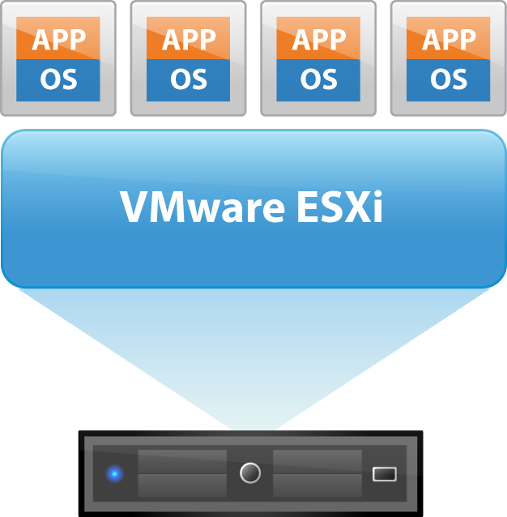
Why ESXi?
Next generation of VMware’s Hypervisor Architecture
Full-featured hypervisor
Superior consolidation and scalability
Same performance as VMware ESX architecture
More secure and reliable
Small code base thanks to OS-Independent, thin architecture
Streamlined deployment and configuration
Fewer configuration items making it easier to maintain consistency
Automation of routine tasks through scripting environments such as vCLI or PowerCLI
Simplified hypervisor Patching and Updating
Smaller code base = fewer patches
The “dual-image” approach lets you revert to prior image if desired
VMware components and third party components can be updated independently
Notes:
Benefits of VMware ESXi Hypervisor Architecture
ESXi is our latest hypervisor architecture and it has been optimized for maximum reliability, performance, and ease of management.
It has a compact design, it is the only hypervisor architecture that is OS independent. No service console so all management has to be done outside of the server – better architecture for management, higher reliability b/c of its small attack surface, high performance
It’s simpler to deploy
The hypervisor architecture of VMware vSphere plays a critical role in the management of the virtual infrastructure. The introduction of the bare-metal ESX architecture in 2001 significantly enhanced performance and reliability, which in turn allowed customers to extend the benefits of virtualization to their mission-critical applications. Once again, the introduction of the ESXi architecture represents a similar leap forward in reliability and virtualization management. Less than 5% of the size of ESX, VMware ESXi runs independently of an operating system and improves hypervisor management in the areas of security, deployment and configuration, and ongoing administration.
Full Featured
Improve Reliability and Security.
The older architecture of VMware ESX relies on a Linux-based console operating system (OS) for serviceability and agent-based partner integration. In the new, operating-system independent ESXi architecture, the approximately 2 GB console OS has been removed and the necessary management functionality has been implemented directly in the core kernel. Eliminating the console OS drastically reduces the codebase size of ESXi to approximately 100 MB improving security and reliability by removing the security vulnerabilities associated with a general purpose operating system.
1 image
Streamline Deployment and Configuration.
ESXi has far fewer configuration items than ESX, greatly simplifying deployment and configuration and making it easier to maintain consistency.
Reduce Management Overhead.
The API-based partner integration model of ESXi eliminates the need to install and manage third party management agents. You can automate routine tasks by leveraging remote command line scripting environments such as vCLI or PowerCLI.
Simplify Hypervisor Patching and Updating.
Due to its smaller size and fewer components, ESXi requires far fewer patches than ESX, shortening service windows and reducing security vulnerabilities. Over its lifetime, ESXi 3.5 required approximately 10 times fewer patches than ESX 3.5.

Slide 9
The Gartner Group says…
“The major benefit of ESXi is the fact that it is more lightweight — under 100MB versus 2GB for VMware ESX with the service console.”
“Smaller means fewer patches”
“It also eliminates the need to manage a separate Linux console (and the Linux skills needed to manage it)…”
“VMware users should put a plan in place to migrate to ESXi during the next 12 to 18 months.”
Source: Gartner, August 2010

Slide 10

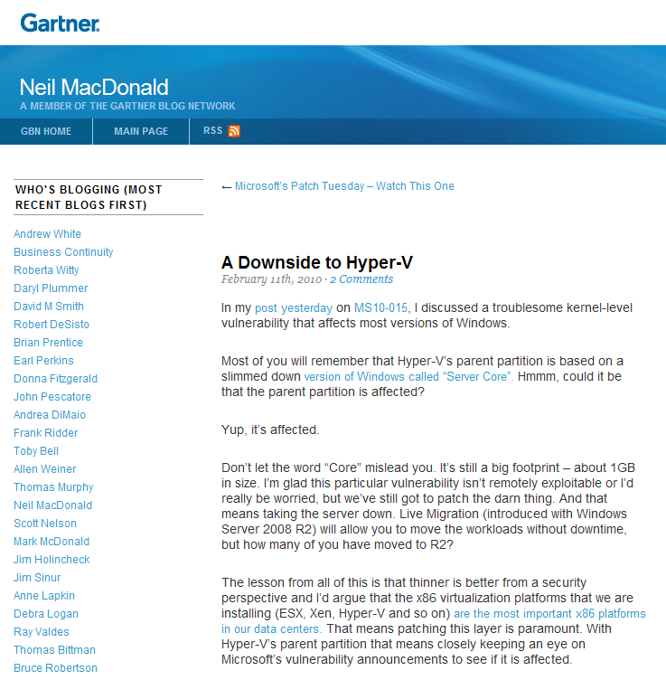
Gartner Agrees ESXi is competitive advantage
“The lesson from all of this is that thinner is better from a security perspective and I’d argue that the x86 virtualization platforms that we are installing (ESX, Xen, Hyper-V and so on) are the most important x86 platforms in our data centers. That means patching this layer is paramount. With Hyper-V’s parent partition that means closely keeping an eye on Microsoft’s vulnerability announcements to see if it is affected.”
Source: http://blogs.gartner.com/neil_macdonald/2010/02/11/a-downside-to-hyper-v/

Slide 11
Agenda
ESXi Convergence and ESXi Value Proposition
Hardware Monitoring and System Management with ESXi
Security and Deployment Options
Command Line Interfaces
Diagnostics and troubleshooting
Answering common questions
Resources and call to action

Slide 12
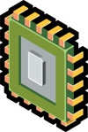


Hardware Monitoring with CIM
Common Information Model (CIM)
Agent-less, standards-based monitoring of hardware resources
Output readable by 3rd party management tools via standard APIs
VMware and Partner CIM providers for specific hardware devices
Management Server
Management
Client
WS-MAN
CIM Broker
VMkernel
VMware Providers
Partner Providers
Platform
CPU
Memory
Network
Storage
Hardware
Notes:
12
12
CIM is a protocol for communication between the server and the client AND a data model to represent the functionality

Slide 13
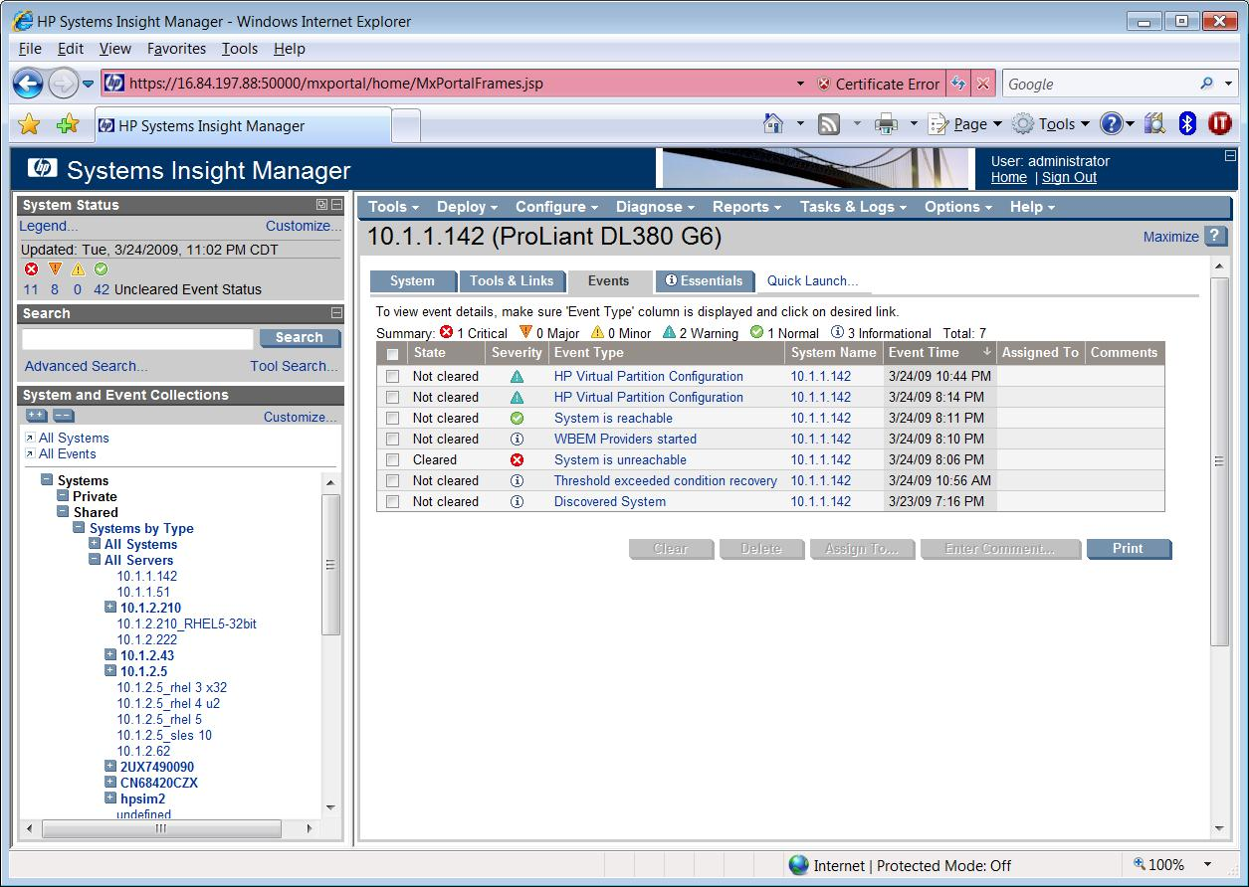
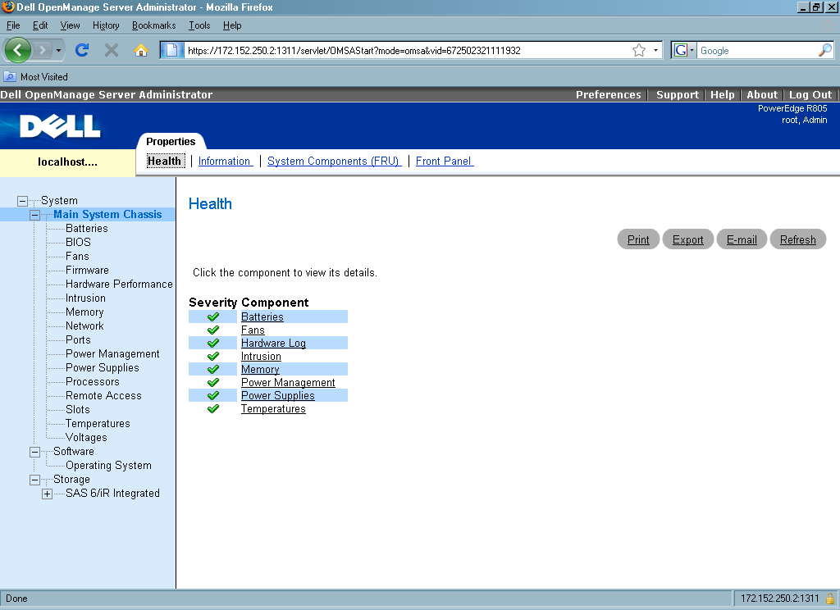
Third Party Hardware Monitoring
OEMs HW monitoring through their management consoles
HP SIM 5.3.2+
Dell Open Manager Server Administrator 6.1
View server and storage asset data
View server and storage health information
View alerts and command logs
Notes:
Starting with HP SIM 5.3.2 following is available on ESXi:
Network Provider – Ethernet ports information, statistics, port link status and IP and MAC addresses.
SmartArray Provider – Controller information, storage enclosure and drive cage information, disk drives and spare drives information.
PCI Provider – PCI device, adapter card and slot information.
Sensor Provider – Temperature Sensors information (for CPU, chassis, Memory), temperature sensors threshold values and current readings
Software Inventory – Ethernet adapter driver versions, CIM provider version and Server Active ROM and redundant ROM versions.

Slide 14
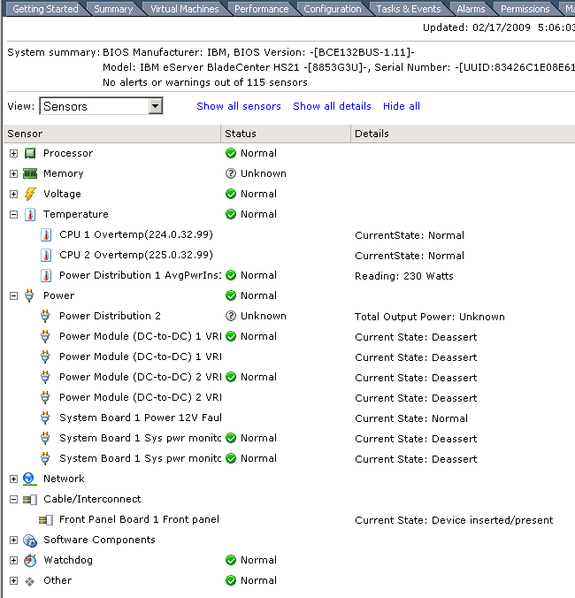
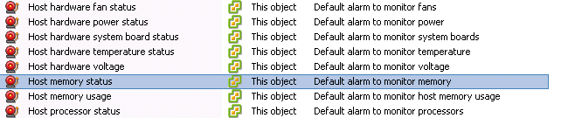
Monitor and Manage Health of Server Hardware with vCenter
CIM Interface
Detailed hardware health monitoring
vCenter alarms alert when hardware failures occur
Host hardware fan status
Host hardware power status
Host hardware system board status
Host hardware temperature status
4256413507
vCenter Alarms for Hardware
Notes:
New CIM SMASH interface for ESX Host health monitoring is integrated as a tab within VMware vCenter. VMware vCenter remains your single pane of glass into management physical and virtual visibility on server health
Integrated with vCenter alarm interface
Notes:
CIM SMASH – VMware hypervisors implement the industry-standard Common Information Model (CIM) interface to monitor and manage the health of server hardware. The implementation is based on the System Management Architecture for Server Heardware (SMASH) profiles defined by DMTF.
Not all hardware vendors publish info through CIM
All thresholds and details are defined by the hardware vendors

Slide 15
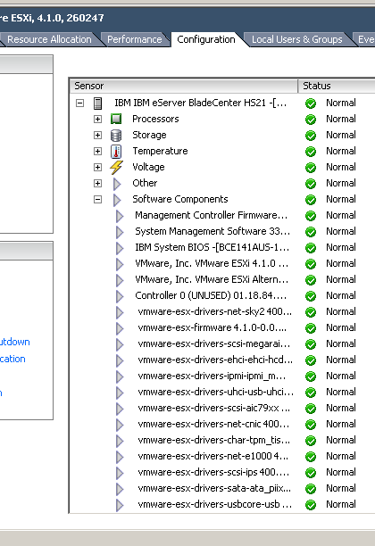
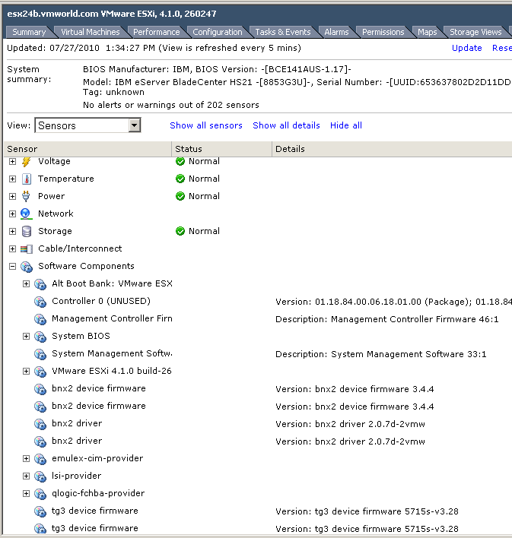
Monitoring of Installed Software Components
In ESXi 4.1 Directly
In vCenter Server

Slide 16




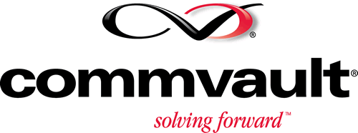







Majority of Systems Management and Back Up Vendors Support ESXi
BPM for Virtual Servers BPA for Virtual Servers Capacity Mgmt Essentials Atrium Orchestrator Bladelogic Operations Manager ProactiveNet Client Automation Atrium Discovery & Dependency Mapping
CA Virtual Performance Manager (VPM) Spectrum Automation Management Spectrum eHealth Cohesion ARCserve
Operations Orchestration VI SPI Client Automation DDM Operations Agent UCMDB SiteScope Performance Agent DataProtector HP Operations
ITM for Virtual Servers TPM ITUAM ITLCM Tivoli Storage Manager
Smarts ESM ADM ControlCenter Avamar Networker

Slide 17
Agenda
ESXi Convergence and ESXi Value Proposition
Hardware Monitoring and System Management with ESXi
Security and Deployment Options
Command Line Interfaces
Diagnostics and troubleshooting
Answering common questions
Resources and call to action

Slide 18
Infrastructure Services for Production Environments
Function | ESX | ESXi
Time synchronization | NTP agent in COS | Built-in NTP service
Centralized log collection | Syslog agent in COS | Built-in Syslog service
SNMP monitoring | SNMP agent in COS | Built-in SNMP service
Persistent Logging | Filesystem of the COS | Log to files on datastore
Local access authentication | AD agent in COS, Built-in Active Directory service | Built-in Active Directory service
Large-Scale Deployment | Boot from SAN, PXE Install, Scripted installation | Boot from SAN, PXE install, Scripted install
New in vSphere 4.1

Slide 19
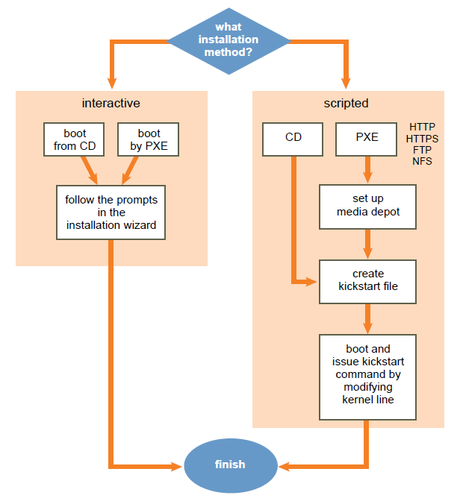
New Feature: PXE and Scripted Installation
Details
Numerous choices for installation
Installer booted from
CD-ROM (default)
Preboot Execution Environment (PXE)
ESXi Installation image on
CD-ROM (default), HTTP/S, FTP, NFS
Script can be stored and accessed
Within the ESXi Installer ramdisk
On the installation CD-ROM
HTTP / HTTPS, FTP, NFS
Config script (“ks.cfg”) can include
Preinstall
Postinstall
First boot
Notes:
Second features we have implemented is more choice during install. We can now do PXE boot, and we can script it too.
Scripted Installation, the equivalent of Kickstart, is now available. The installer can boot over the network, and at that point you can also do an interactive installation, or else set it up to do a scripted installation. Both the installed image and the config file (called “ks.cfg”) can be obtained over the network using a variety of protocols. There is also an ability to specify preinstall, postinstall, and first-boot scripts. For example, the postinstall script can configure all the host settings, and the first boot script could join the host to vCenter. These three types of scripts run either in the context of the Tech Support Mode or in Python. The Tech Support Mode shell is a highly stripped down version of bash.
You can start the scripted installation with a CD-ROM drive or over the network by using PXE booting. You cannot use scripted installation to install ESXi to a USB device

Slide 20
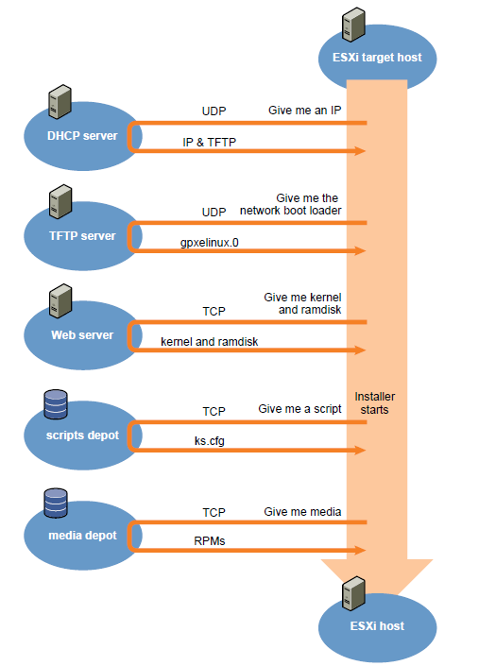
New Feature: PXE Installation
Requirements
PXE-capable NIC
DHCP Server (IPv4)
Media depot + TFTP server + PXE
A server hosting the entire content of ESXi media
Protocal: HTTP/HTTPS, FTP, or NFS server.
OS: Windows/Linux server
Notes:
I’ve added this slide for those who are not familiar with PXE Boot.
TFTP is a light-weight version of the FTP service, and is typically used only for network booting systems or loading firmware on network devices such as routers.

Slide 21
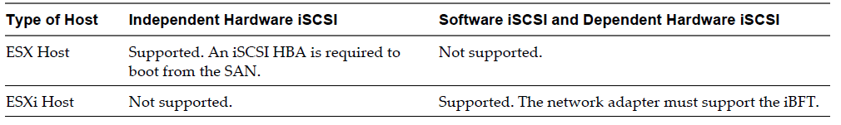
New Feature: Boot from SAN
Boot from SAN fully supported in ESXi 4.1
Requirements outlined in SAN Configuration Guide:
An iBFT (iSCSI Boot Firmware Table) NIC is required
iBFT communicates info about the iSCSI boot device to an OS
Notes:
One of the most popular requests among customers is to improve the deployment and management of ESXi.
First in the line is boot From SAN is now fully supported in ESXi 4.1. It was as only experimentally supported in ESXi 4.0. Boot from SAN will be supported for FC, iSCSI, and FCoE. For iSCSI and FCoE, it will depend upon hardware qualification, so please check the HCL and Release Notes when vSphere 4.1 is released.
From http://www.vmware.com/resources/compatibility/info.php?deviceCategory=san&mode=san_introduction
Software iSCSI Adapter: A software iSCSI adapter is a VMware code built into the VMkernel. It allows the host to connect to the iSCSI storage device through standard network adapters. The software iSCSI adapter handles iSCSI processing while communicating with the network adapter. With the software iSCSI adapter, you can use iSCSI technology without purchasing specialized hardware.
Hardware iSCSI Adapter: A hardware iSCSI adapter is a third-party adapter that offloads iSCSI and network processing from your host. Hardware iSCSI adapters are divided into categories.
Dependent Hardware iSCSI Adapter: Depends on VMware networking, and iSCSI configuration and management interfaces provided by VMware. This type of adapter can be a card that presents a standard network adapter and iSCSI offload functionality for the same port. The iSCSI offload functionality depends on the host's network configuration to obtain the IP, MAC, and other parameters used for iSCSI sessions. An example of a dependent adapter is the iSCSI licensed Broadcom 5709 NIC.
Independent Hardware iSCSI Adapter: Implements its own networking and iSCSI configuration and management interfaces. An example of an independent hardware iSCSI adapter is a card that either presents only iSCSI offload functionality or iSCSI offload functionality and standard NIC functionality. The iSCSI offload functionality has independent configuration management that assigns the IP, MAC, and other parameters used for the iSCSI sessions. An example of a independent adapter is the QLogic QLA4052 adapter.
Hardware iSCSI adapters might need to be licensed. Otherwise, they will not appear in the vSphere Client or vSphere CLI. Contact the adapter's vendor for licensing information.Please refer to the I/O Compatibility Guide for a list of hardware iSCSI adapters and NIC that can be used with ESX.

Slide 22
Active Directory Integration
Provides authentication for all local services
Remote access based on vSphere API, vSphere Client, PowerCLI, etc
Works with Active Directory users as well as groups
Can grant varying levels of privileges, e.g. full administrative, read-only or custom
AD Group “ESX Admins” will be granted Administrator role
Notes:
Another feature that was requested a lot is to integrate with Microsoft AD. This further simplify the management of vSphere as we can now be consistent with vCenter.
AD integration provides authentication for all local services. This means access via Admin Client, via the console, via remote console are all based on AD.

Slide 23
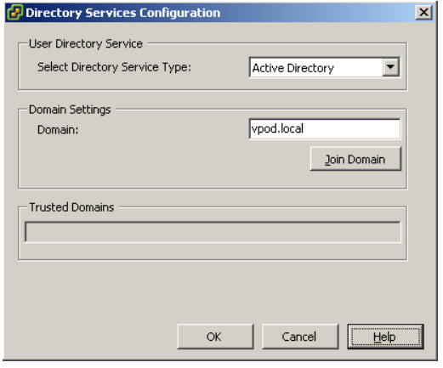
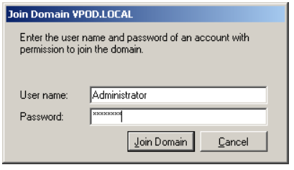
Configuration of Active Directory in vSphere Client
1. Select “Active Directory”
2. Click “Join Domain”
3. Provide valid credentials
Notes:
From the dialog box that pops up, select “Active Directory” from the drop down.
Then specify the Domain name.
Then click “Join Domain”. The next dialog box will pop up to let you enter the ID which can join a domain.
Click on Join Domain button to join the domain. If there is an error, an error message will be prompted. If not, ESXi will join the domain.

Slide 24
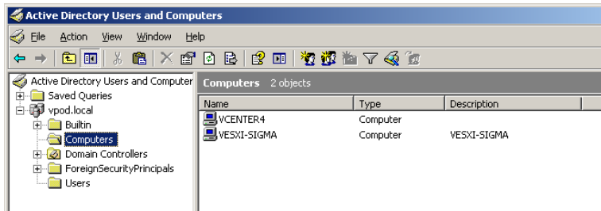
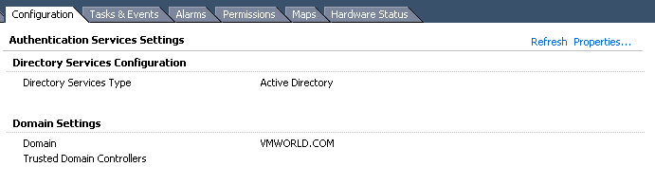
Active Directory Service
Host will appear in the Active Directory “Computers” Object listing
vSphere Client will indicate which domain is joined

Slide 25
New Feature: Total Lockdown
Ability to totally control local access via vCenter Server
Lockdown Mode (prevents all access except root on DCUI)
DCUI – can additionally disable separately
If both configured, then no local activity possible (except pull the plugs)
Access Mode | Normal | Lockdown
vSphere API (e.g., vSphere Client, PowerCLI, vCLI, etc) | Any user, based on local roles/privileges | None (except vCenter vpxuser)
CIM | Any user, based on local role/privilege | None (except via vCenter ticket)
DCUI | Root and users with Admin privileges | Root only
Tech Support Mode (Local and Remote) | Root and users with Admin privileges | None

Slide 26
Agenda
ESXi Convergence and ESXi Value Proposition
Hardware Monitoring and System Management with ESXi
Security and Deployment Options
Command Line Interfaces
Diagnostics and troubleshooting
Answering common questions
Resources and call to action

Slide 27
vCLI and PowerCLI: primary Scripting Interfaces
vCLI
vSphere PowerCLI
Other utility scripts
Other languages
vSphere SDK
vSphere Client
vSphere Web Service API
vCLI and PowerCLI built on same API as vSphere Client
Same authentication (e.g. Active Directory), roles and privileges, event logging
API is secure, optimized for remote environments, firewall-friendly, standards-based
Notes:
27
27
27

Slide 28
New Feature: Additional vCLI Configuration Commands
Storage
esxcli swiscsi session: Manage iSCSI sessions
esxcli swiscsi nic: Manage iSCSI NICs
esxcli swiscsi vmknic: List VMkernel NICs available for binding to particular iSCSI adapter
esxcli swiscsi vmnic: List available uplink adapters for use with a specified iSCSI adapter
esxcli vaai device: Display information about devices claimed by the VMware VAAI (vStorage APIs for Array Integration) Filter Plugin.
esxcli corestorage device: List devices or plugins. Used in conjunction with hardware acceleration.

Slide 29
Agenda
ESXi Convergence and ESXi Value Proposition
Hardware Monitoring and System Management with ESXi
Security and Deployment Options
Command Line Interfaces
Diagnostics and troubleshooting
Answering common questions
Resources and call to action

Slide 30
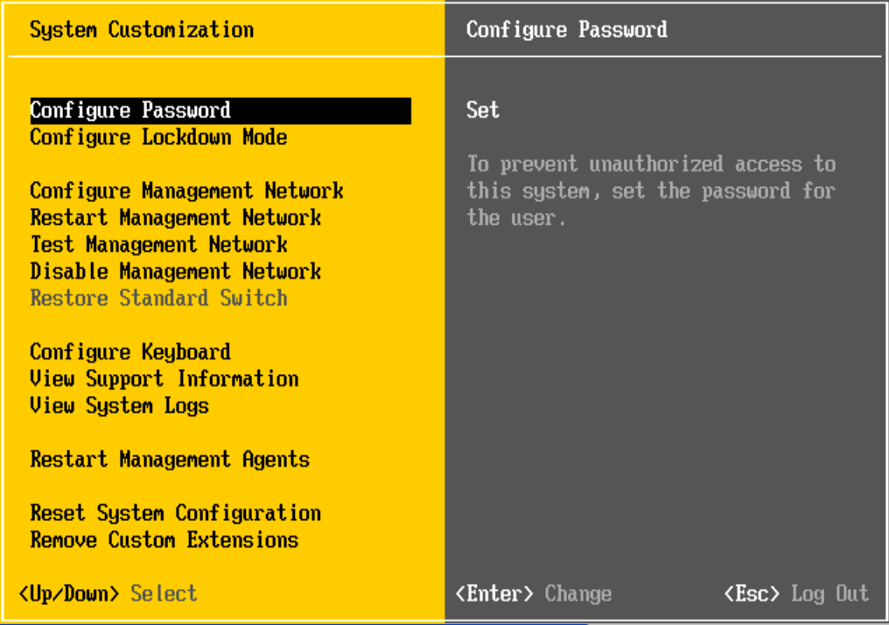
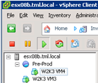
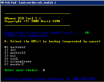
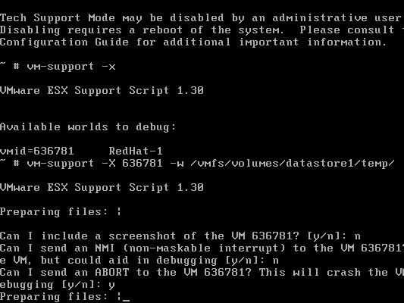
Summary of ESXi Diagnostics and Troubleshooting
Initial Diagnostics
Advanced Situations
DCUI: misconfigs / restart mgmt agents
Browser
vCLI
vSphere APIs
ESXi
TSM: In-depth troubleshooting
API Access
Direct Access

Slide 31
Diagnostic Commands for ESXi: vCLI
Familiar set of ‘esxcfg-*’ commands available in vCLI
Names mapped to ‘vicfg-*’
Also includes
vmkfstools
vmware-cmd
resxtop
esxcli: suite of diagnostic tools

Slide 32
New Feature: Additional vCLI Troubleshooting Commands
Network
esxcli network: List active connections or list active ARP table entries.
Storage
NFS statistics available in resxtop
VM
esxcli vms vm kill: Forcibly stop VMs that do not respond to normal stop operations, by using kill commands.
# esxcli vms vm kill --type <kill_type> --world-id <ID>
NOTE: designed to kill VMs in a reliable way (not dependent upon well-behaving system)
Eliminates one of the most common reasons for wanting to use TSM.
Notes:
Other new vCLI commands include network troubleshooting and new information exposed in resxtop. Finally, the ability to forcibly kill a VM has been added to vCLI, thus eliminating one of the most common reasons for wanting to use TSM. The kill type can be soft, hard or force. With soft, we give the VM a chance to shut down cleanly.
_________________________________________________________________________________
The command supports three --type options. Try the types sequentially (soft before hard, hard before
force). The following types are supported through the --type option:
■ soft – Gives the VMX process a chance to shut down cleanly (like kill or kill -SIGTERM)
■ hard – Stops the VMX process immediately (like kill -9 or kill -SIGKILL)
■ force – Stops the VMX process when other options do not work.

Slide 33
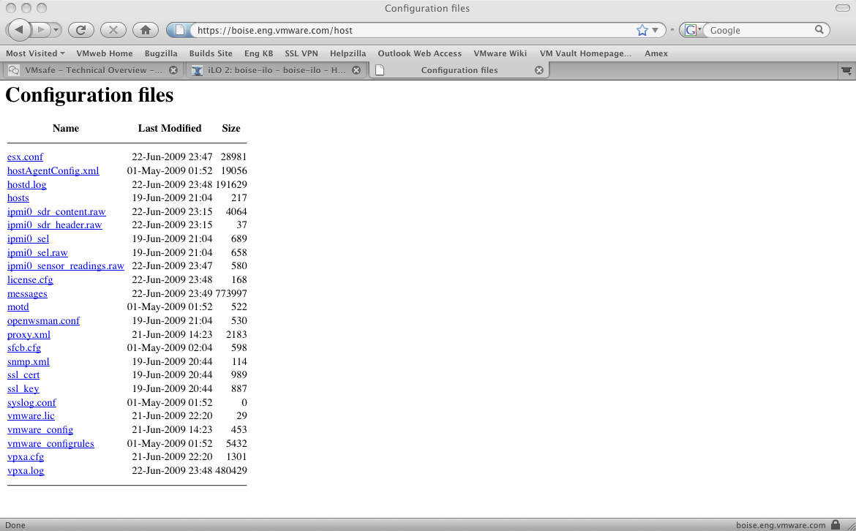
Browser-based Access of Config Files
https://<hostname>/host

Slide 34
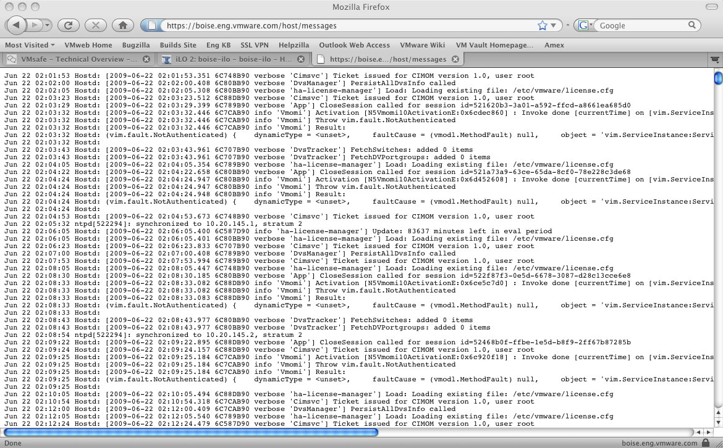
Browser-based Access of Log Files
https://<hostname>/host/messages

Slide 35
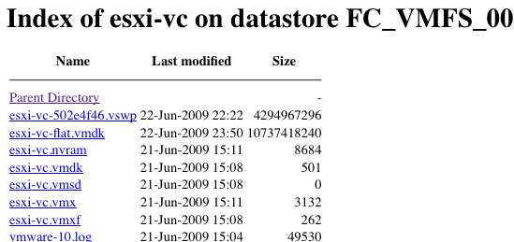
Browser-based Access of Datastore Files
https://<hostname>/folder
Disk Descriptor

Slide 36
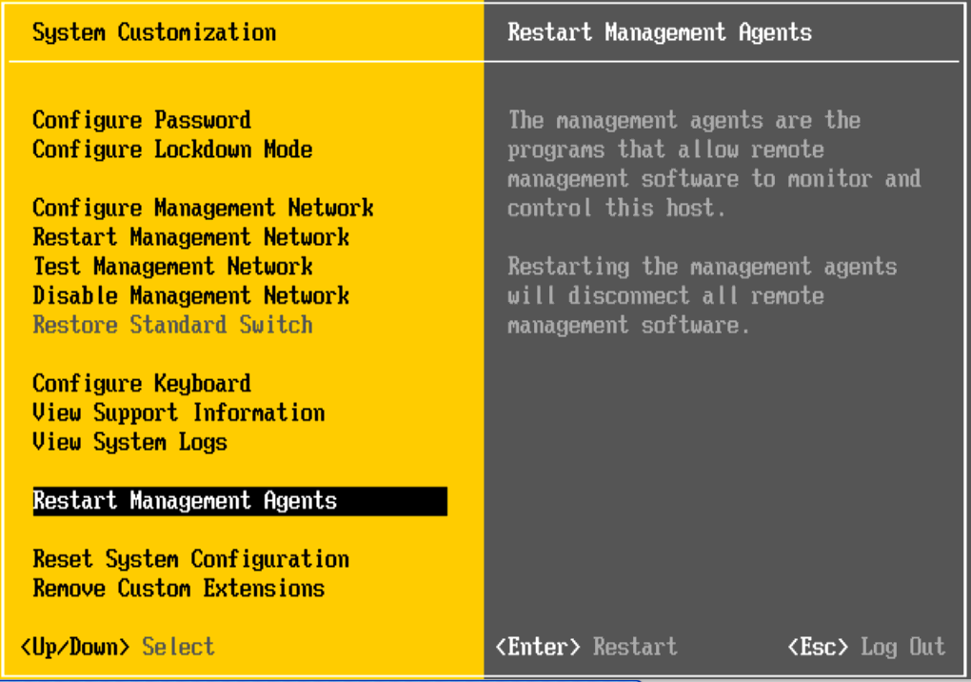
DCUI-based Troubleshooting
Menu item to restart all management agents, including
Hostd
Vpxa
Menu item to reset all configuration settings
Fix a misconfigured vNetwork Distributed Switch
Reset all configurations

Slide 37
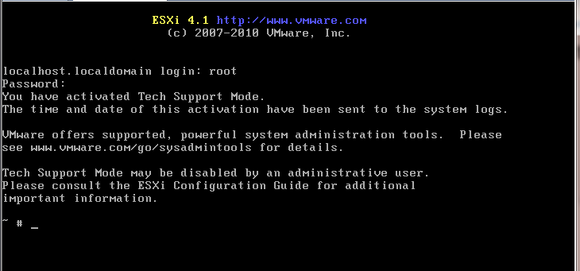
New Feature: Full Support of Tech Support Mode
Two ways to access
Local: on console of host (press “Alt-F1”)
Remote: via SSH
Notes:
Finally, the Tech Support Mode is fully supported. We support both the local, when you are in front of the server, or remote, when you are using SSH.
In ESXi 4.0, Tech Support Mode usage was ambiguous. We stated that you should only use it with guidance from VMware Support, but VMware also issued several KBs telling customers how to use it. Getting into Tech Support Mode was also not very user-friendly.
The warning not to use TSM has been removed from the login screen. However, anytime TSM is enabled (either local or remote), a warning banner will appear in vSphere Client for that host. This is meant to reinforce the recommendation that TSM only be used for fixing problems, not on a routine basis.
The SysAdminTools URL in the message above will take you to vMA, PowerCLI, CLI, etc.

Slide 38
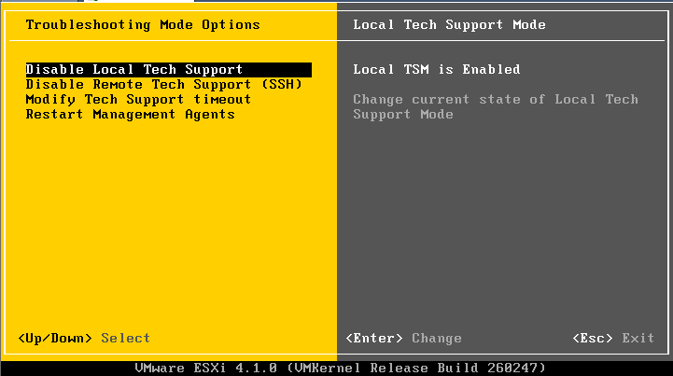
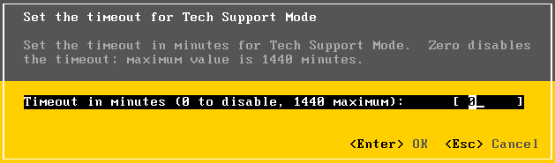
New Feature: Full Support of Tech Support Mode
Toggle on DCUI
Disable/Enable
Both Local and Remote
Optional timeout automatically disables TSM (local and remote)
Running sessions are not terminated.
New sessions are rejected
All commands issued in Tech Support Mode are sent to syslog
Notes:
To enable or disable from the console, it’s pretty straight forward.
By default, after you enable TSM (both local and remote), they will automatically become disabled after 10 minutes. This time is configurable, and the timeout can also be disabled entirely. When TSM times out, running sessions are not terminated, allowing you to continue a debugging session. All commands issued in TSM are logged by hostd and sent to syslog, allowing for an incontrovertible audit trail.
When lockdown mode is enabled, DCUI access is restricted to the root user (so root can still go in), while access to Tech Support Mode is completely disabled for all users. With lockdown mode enabled, access to the host for management or monitoring using CIM is possible only through vCenter Server. Direct access to the host using the vSphere Client is not permitted.

Slide 39
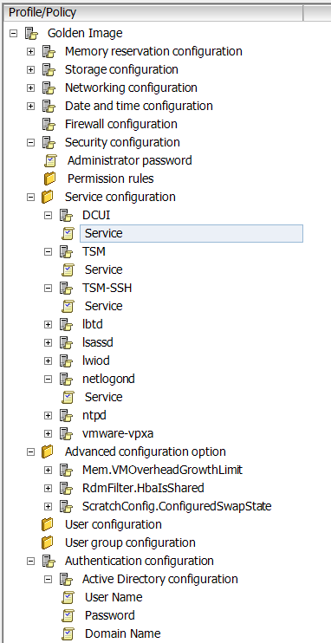
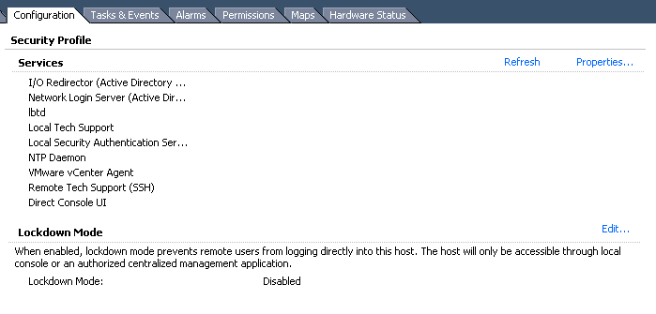
New Feature: Full Support of Tech Support Mode
Can also enable in vCenter Server and Host Profiles

Slide 40
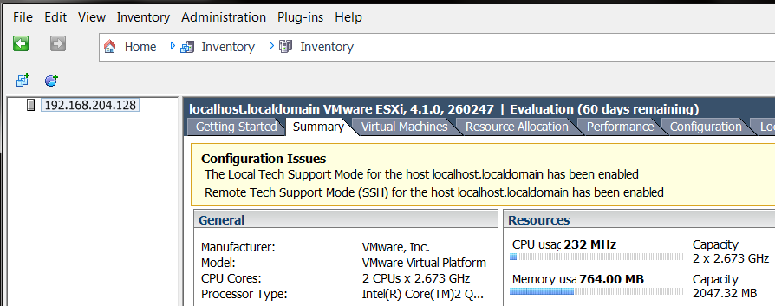
Tech Support Mode use cases
Recommended uses
Support, troubleshooting, and break-fix
Scripted deployment preinstall, postinstall, and first boot scripts
Discouraged uses
Any other scripts
Running commands/scripts periodically (cron jobs)
Leaving open for routine access or permanent SSH connection
Admin will be notified when active
Notes:
As you know, the tech support mode is not for day to day use. So anytime it is enabled, we will flag it.

Slide 41
New Feature: Additional Commands in Tech Support Mode
Additional commands for troubleshooting
vscsiStat
nc (netcat)
tcpdump-uw

Slide 42
Agenda
ESXi Convergence and ESXi Value Proposition
Hardware Monitoring and System Management with ESXi
Security and Deployment Options
Command Line Interfaces
Diagnostics and troubleshooting
Answering common questions
Resources and call to action

Slide 43
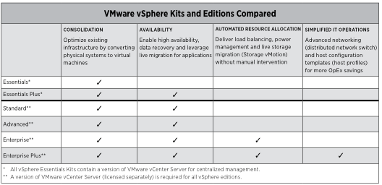
Is ESXi production and enterprise ready? YES
The VMware ESXi hypervisor architecture can be deployed with any vSphere edition and used to address any of its use cases
VMware recommends ESXi for any installation of vSphere 4.x or higher

Slide 44
What is the VMware vSphere Hypervisor?
VMware vSphere Hypervisor is the new name for what was formerly known as VMware ESXi Single Server or free ESXi (often abbreviated to simply “VMware ESXi”).
VMware vSphere Hypervisor is the free edition of the vSphere product line. It is licensed to only unlock the hypervisor functionality of vSphere, but it can be seamlessly upgraded to more advanced offerings of VMware vSphere.
vSphere Hypervisor is based only on the ESXi hypervisor
vSphere Hypervisor is target to virtualization first time users

Slide 45
Is ESXi at feature parity with ESX? Yes!!
Capability | ESXi 4.0 | ESXi 4.1 | ESX 4.1
Admin/config CLIs | PowerCLI + vCLI | PowerCLI + vCLI | COS + vCLI + PowerCLI
Advanced troubleshooting | Tech Support Mode (restricted) | Tech Support Mode (full support) | COS
Scripted installation | Not supported | Supported | Supported
Boot from SAN | Not supported | Supported | Supported
SNMP | Supported | Supported | Supported
Active Directory | Not supported | Integrated | Integrated
HW monitoring | CIM providers | CIM providers | 3rd party agents in COS
Jumbo frames | Supported | Supported | Supported
Web Access | Not supported | Not supported | Not supported
Total Lockdown | Not available | Supported | Not available

Slide 46
How to plan an ESX to ESXi migration
Start testing ESXi
If you’ve not already deployed, there’s no better time than the present
Ensure 3rd party solutions used by your customers are ESXi Ready
Monitoring, backup, management, etc. Most already are.
Bid farewell to agents!
Familiarize with ESXi remote management options
Transition any scripts or automation that depended on the COS
Powerful off-host scripting and automation using vCLI, PowerCLI, …
Plan an ESXi migration as part of vSphere upgrade
Testing of ESXi architecture can be incorporated into overall vSphere testing

Slide 47
Agenda
ESXi Convergence and ESXi Value Proposition
Hardware Monitoring and System Management with ESXi
Security and Deployment Options
Command Line Interfaces
Diagnostics and troubleshooting
Answering common questions
Resources and call to action

Slide 48
Call to action for VMware partners
Learn about ESXi and become an expert
Make sure your customers know about ESXi convergence in the next release of vSphere
Help your customers plan and complete their ESX to ESXi migrations with their upgrade to vSphere 4.1
When working on new vSphere 4.1 deployments advise your customers to deploy ESXi directly

Slide 49
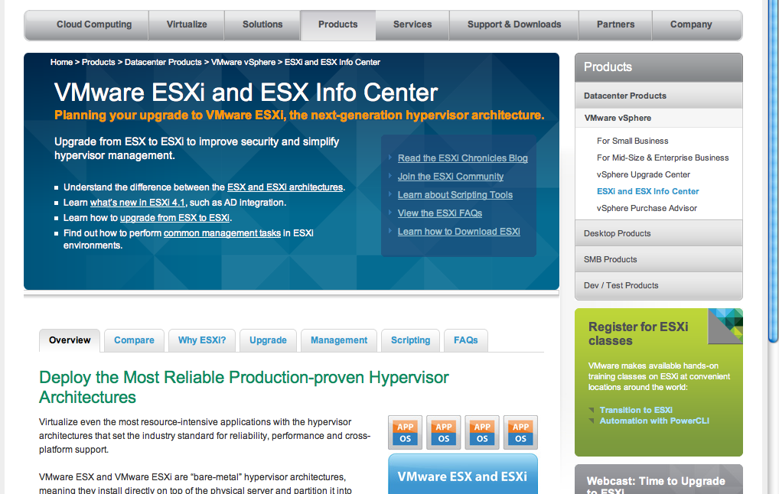
Visit the ESXi and ESX Info Center today
http://vmware.com/go/ESXiInfoCenter

Slide 50
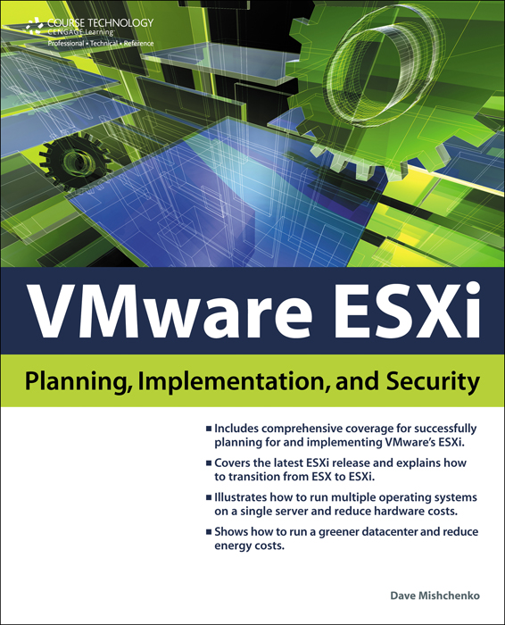
VMware ESXi: Planning, Implementation, Security
Title: VMware ESXi: Planning, Implementation, and Security
Author: Dave Mischenko
ISBN: 1435454952
List Price: $49.99
Release Date: October 2010

